Slide 1
Gist of the workshop
Dr.Sm.Badhusha
Professor/CSE,
Alva’s Institute of Engineering and Technology, Mijar,Mangalore

Slide 2
Data analytics is the process and
methodology of analyzing data
to draw meaningful insight
from the data
Machine Learning is the practice of applying algorithms to extract data and learn from it and forecast the future trends for a particular field

Slide 3

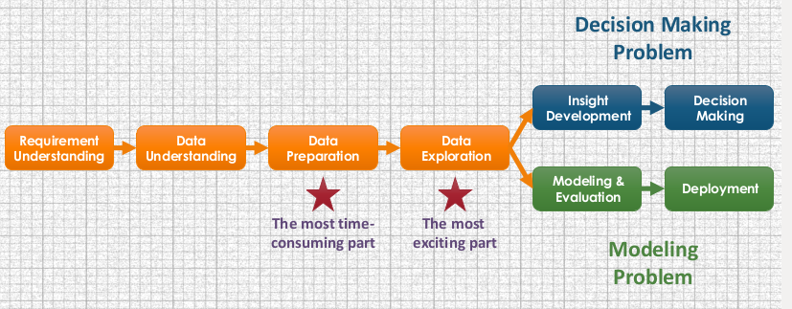
Typical Process of Data Analytics

Slide 4
Python as a Programming Language...
Python is a general-purpose
high-level programming language
Web development
Networking
Scientific computing
Data analytics

Slide 5
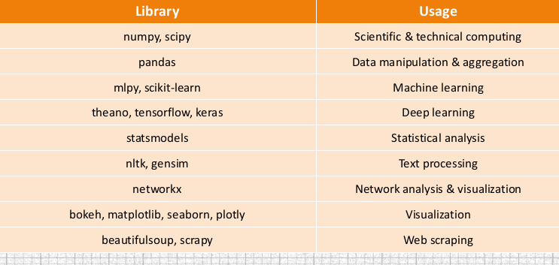
Libraries in Python for hot research areas

Slide 6
The flow of content delivery in the workshop ....
1. Python Basic Programming
2. Identifying the interesting dataset from the web
3. Load the dataset into a Pandas dataframe
4. Check the column names and see the first few rows
5. Data wrangling (cleaning, harmonizing, transposing, merging and filtering)
6. Do analysis with Explonatory Data Analysis (EDA)
7. To find the accuracy of the data analytical model by
applying the Standard ML algorithms.

Slide 7
REFERENCES
Python for Data Analysis by Wes McKinney, Orielly publications
https://www.wikipedia.org/
https://uiowa.edu/datascience/resources

Slide 8
Let us dive
into
the demo and practical sessions 1

